Slide 1
N-Blocks Industrial I/O
Nikos Chalikias
nikolaos.chalikias@cit.ie
TEC@Nimbus Centre
http://nimbus.cit.ie/
Cork Institute of Technology
Ireland

Slide 2
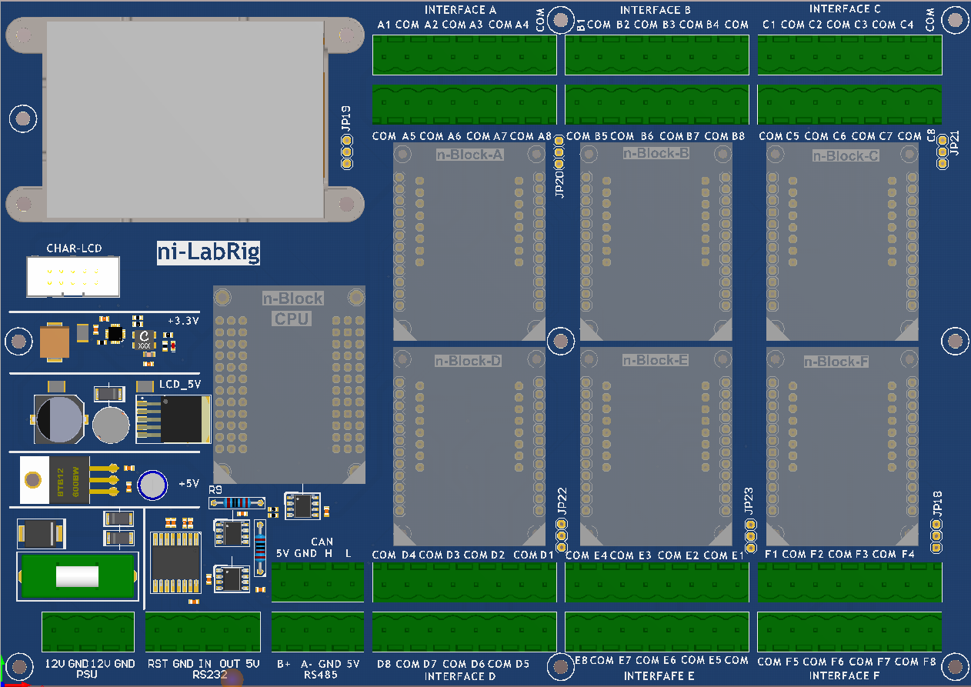
n-Blocks: Industrial I/O: ni-LabRig Motherboard
212 X 149 mm
4X
POWER PWM
OUTPUTS
8X
BIDIRECTIONAL
MOTORS
8X
OC
OUTPUTS
CPU
CPU
8X
OPTO
INPUTS
8X
NTC
4X
LOAD
CELL
Use Case
REQUIREMENTS

Slide 3
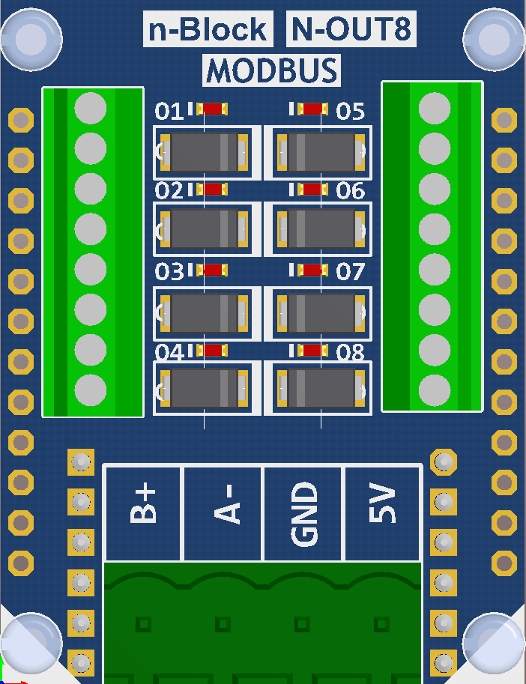
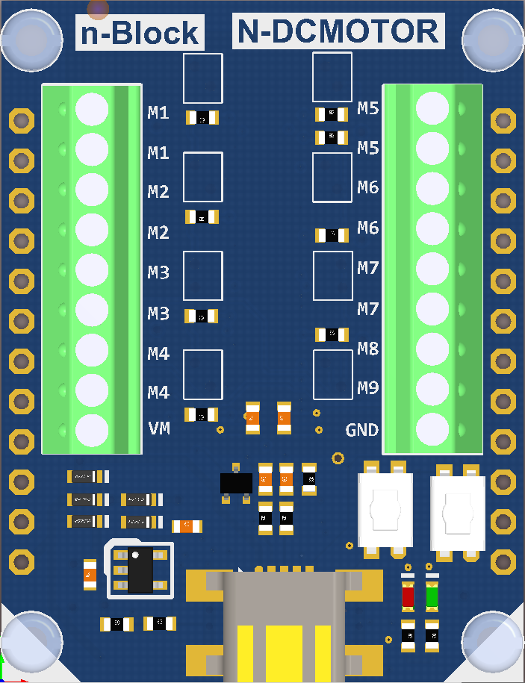
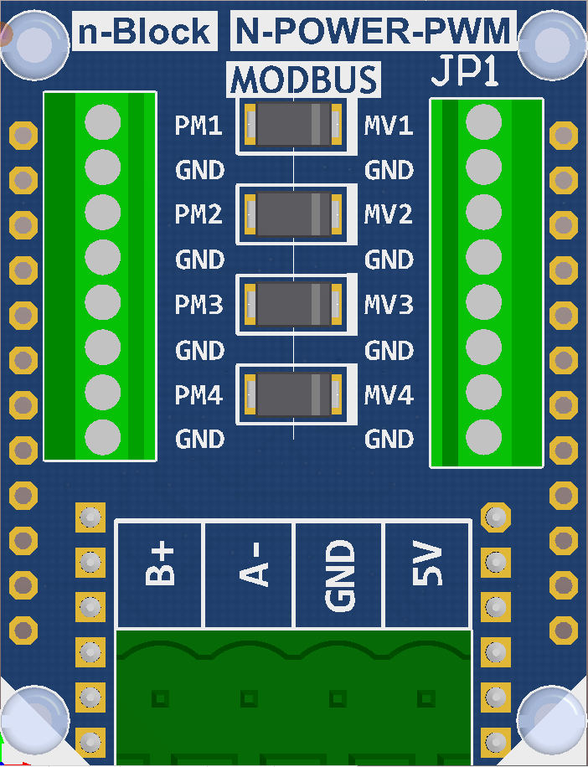
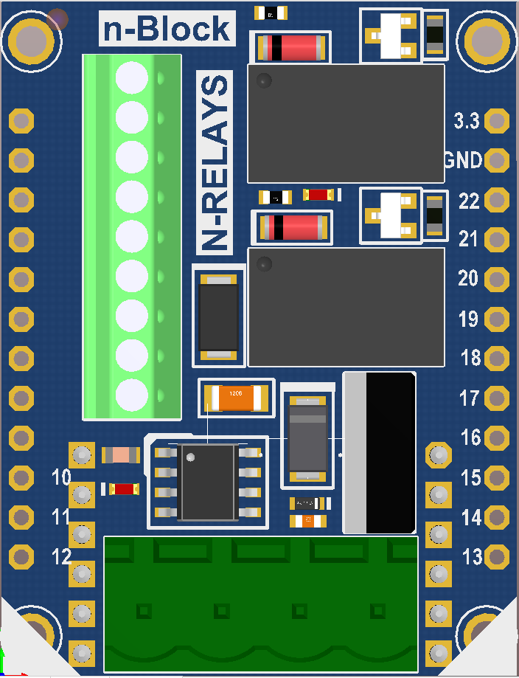
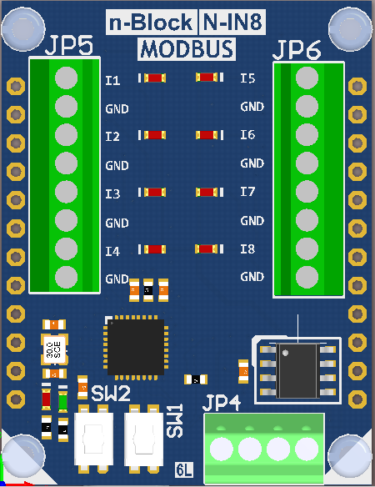
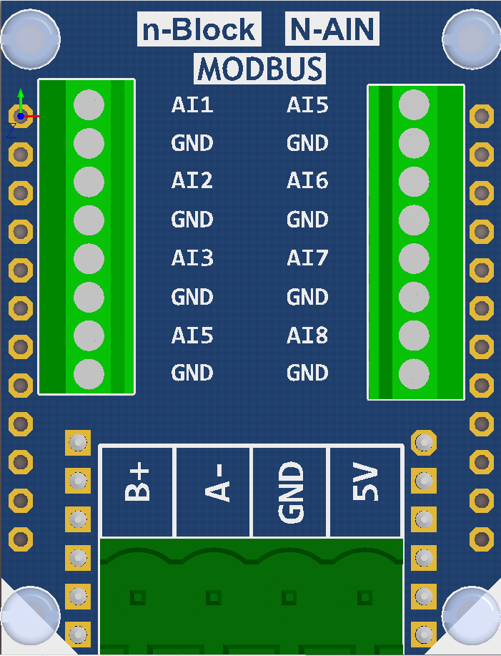
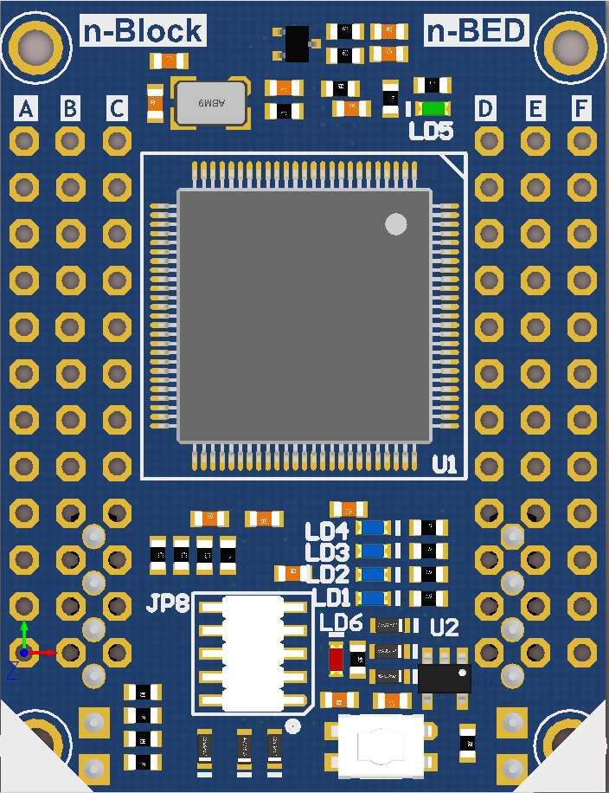
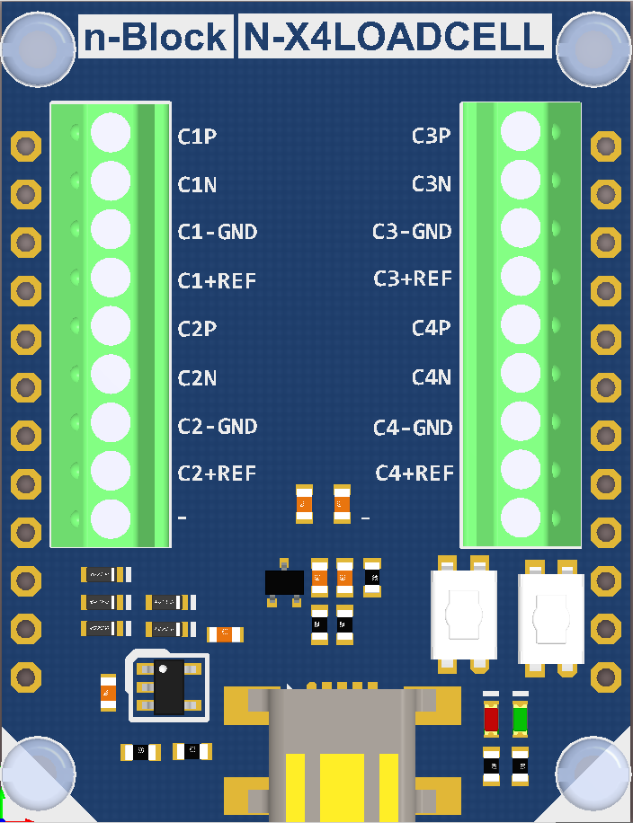
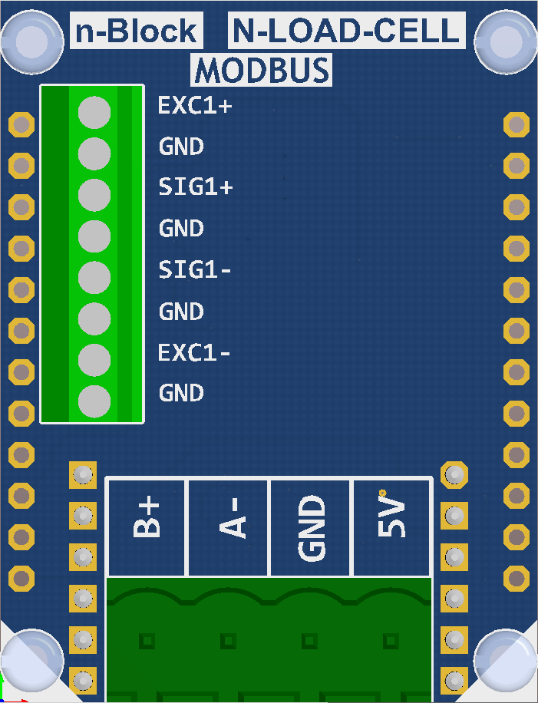
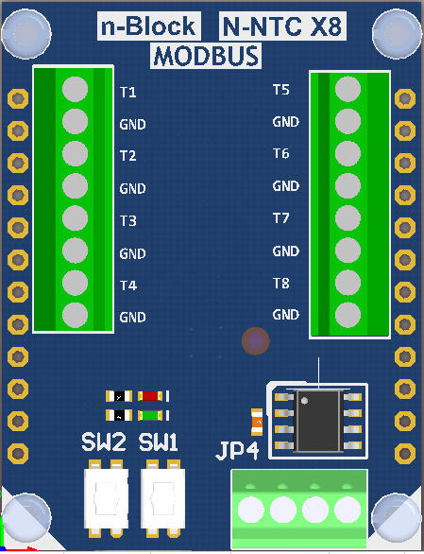
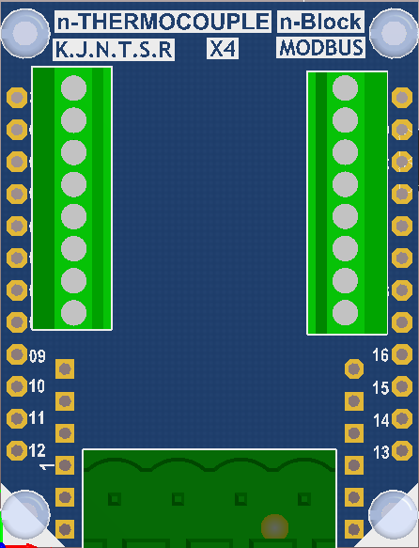
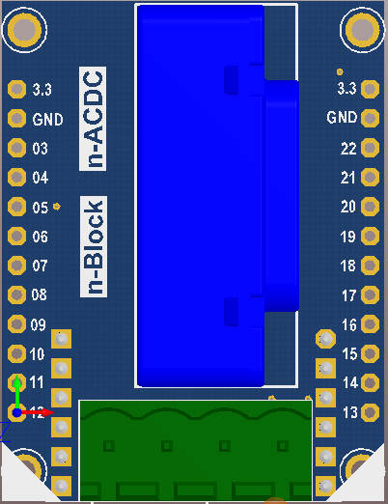
n-Blocks: Industrial I/O
OUTPUTS
INPUTS
N-BLOCKS
CPU
SENSORS

Slide 4
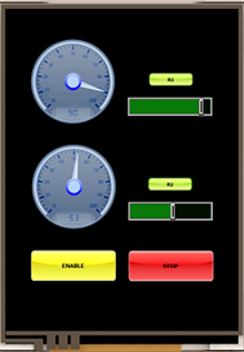
n-Blocks: ni-LabRig with n-Blocks
212 X 149 mm
4 X
POWER PWM
OUTPUTS
8 X BIDIRECTIONAL
MOTORS
4 X
OC
OUTPUTS
**** RAPID ****
Use-case
IMPLEMENTATION
CPU
8 X
DIGITAL
INPUTS
8 X
NTC
INPUTS
4 X
LOAD-CELL

Slide 5
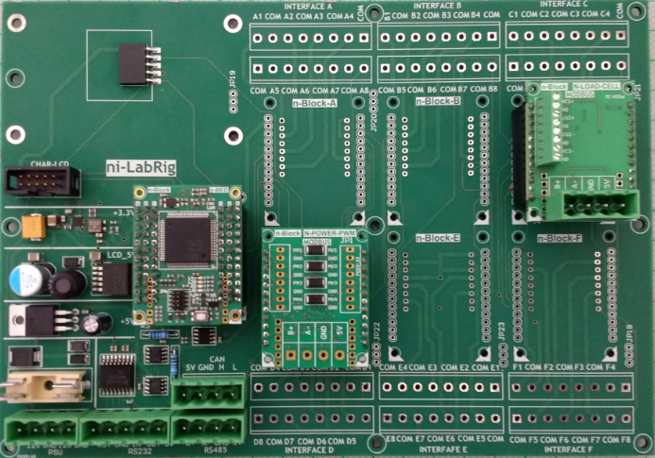
n-Blocks: Industrial I/O: Project Implementation with ni-LabRig
212 X 149 mm

Slide 6
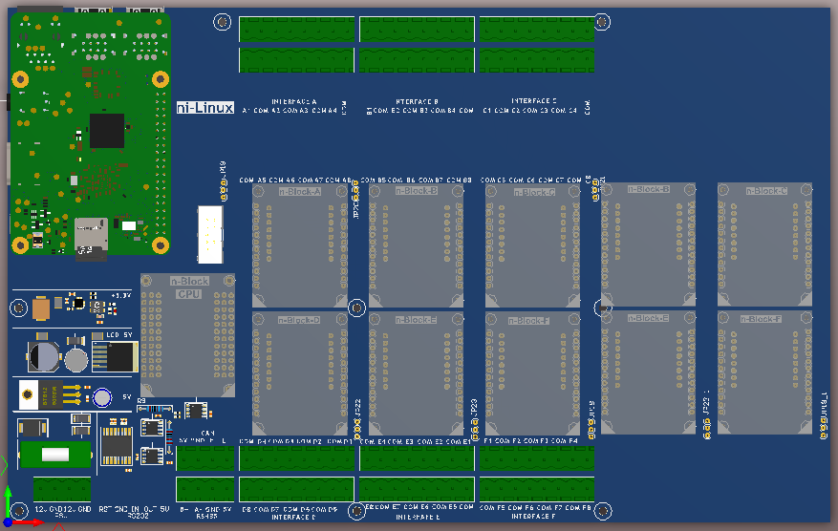
n-Blocks: Industrial I/O:
ni-Linux concept
RASPBERRY PI

Slide 7
n-Blocks: Industrial I/O:
modbus concept
DISTRIBUTED SYSTEMS
FAST INTEGRATION
INTEGRATION WITH THIRD PARTY
INTERFACE CARDS
HOSTS

Slide 8
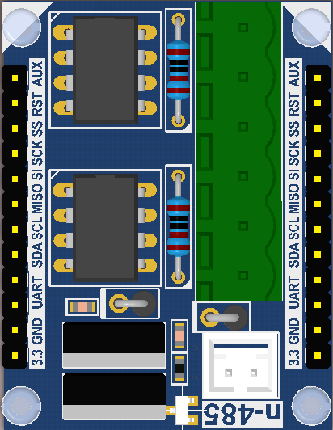
n-Blocks: Industrial I/O: MODBUS
Distributed
No motherboard Systems
RS-485
ni-Gateway
THIRD
PARTY
MODBUS
MODULE
PC, R-PI, or other
HOST

Slide 9
n-Blocks: Industrial I/O: MODBUS
PLC
RS-485

Slide 10
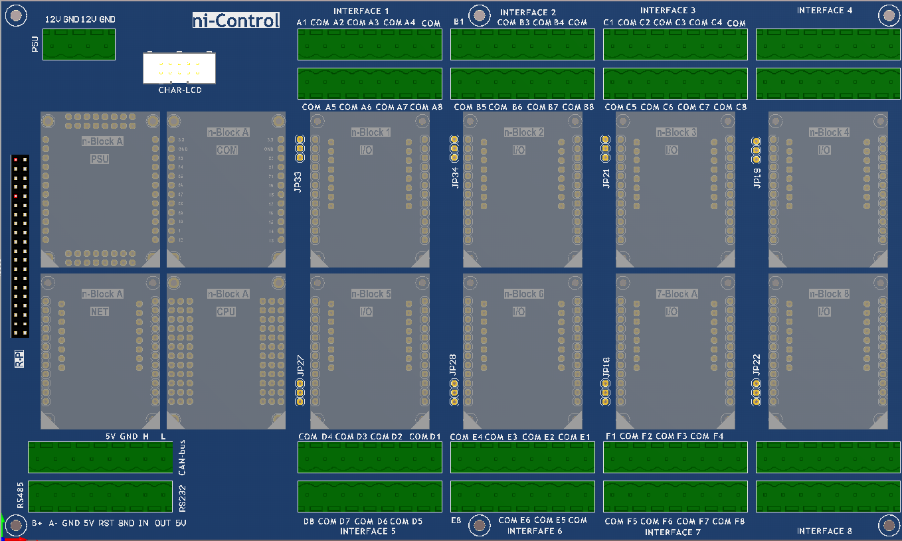
n-Blocks: Industrial I/O: ni-Control concept
250 X 150 mm

Slide 11
n-Blocks: Industrial I/O: ni-Control concept
250 X 150 mm
PSU
INPUT: 12V
OUTPUTS:
5V, 3,3V
RF COM
TEMPERATURE
ENCODERS
MOTOR
STEPPING
MOTOR
STEPPING
RASPBERRY -PI
INDUSTRIAL
NETWORK
CPU
LOADCELL
SWITCHES
MOTOR
BLDC
MOTOR
DC

Slide 12
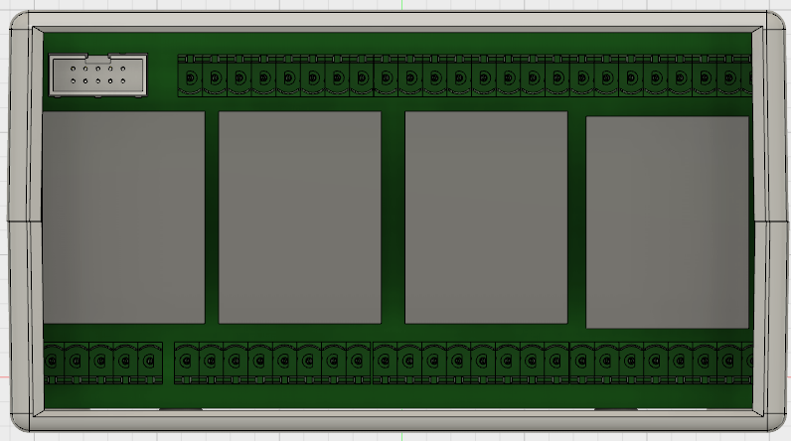
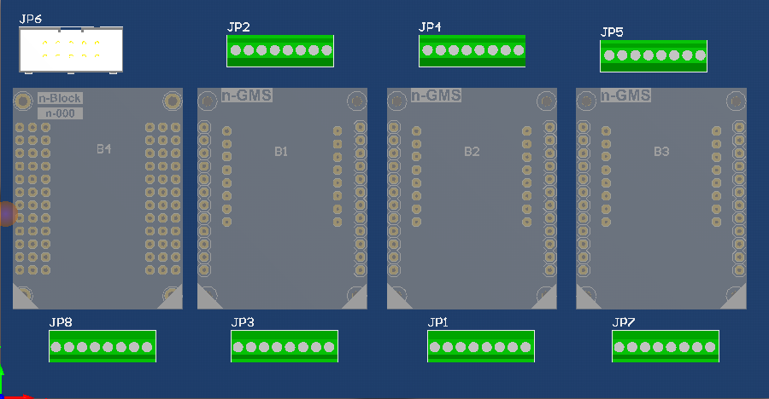
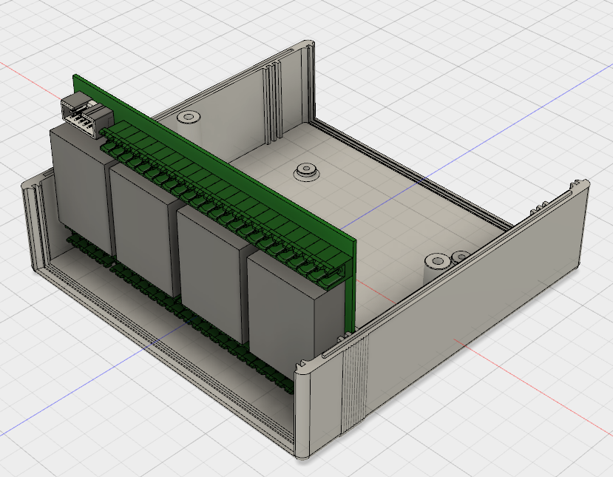
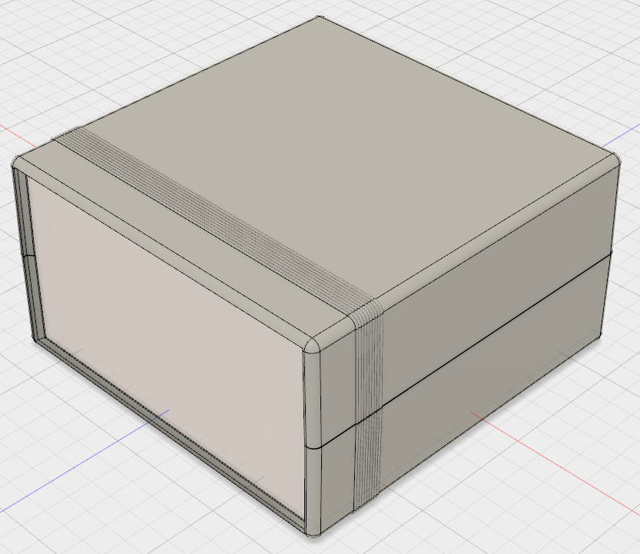
n-Blocks: Industrial I/O:
ni-FRONT concept
150 X 78 mm
POWER
TRANSISTORS
COM
ADC
DAC
ANALOG
PSU
CPU
POTENTIOMETERS
LEDS

Slide 13
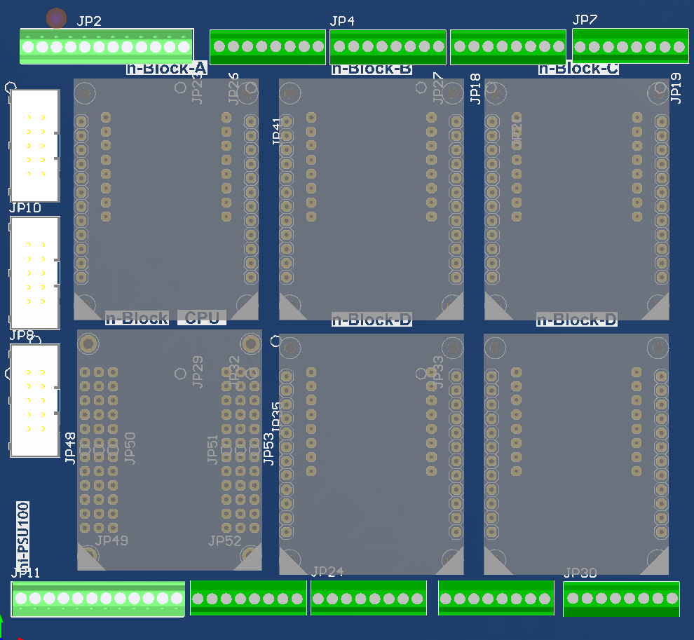
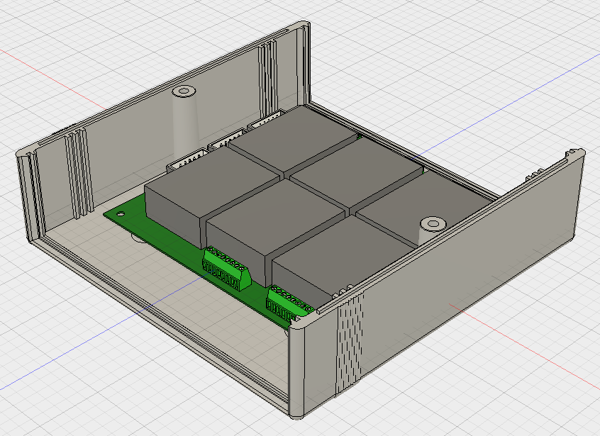
n-Blocks: Industrial I/O:
ni-INSTRUMENT concept
125 X 115 mm

Slide 14
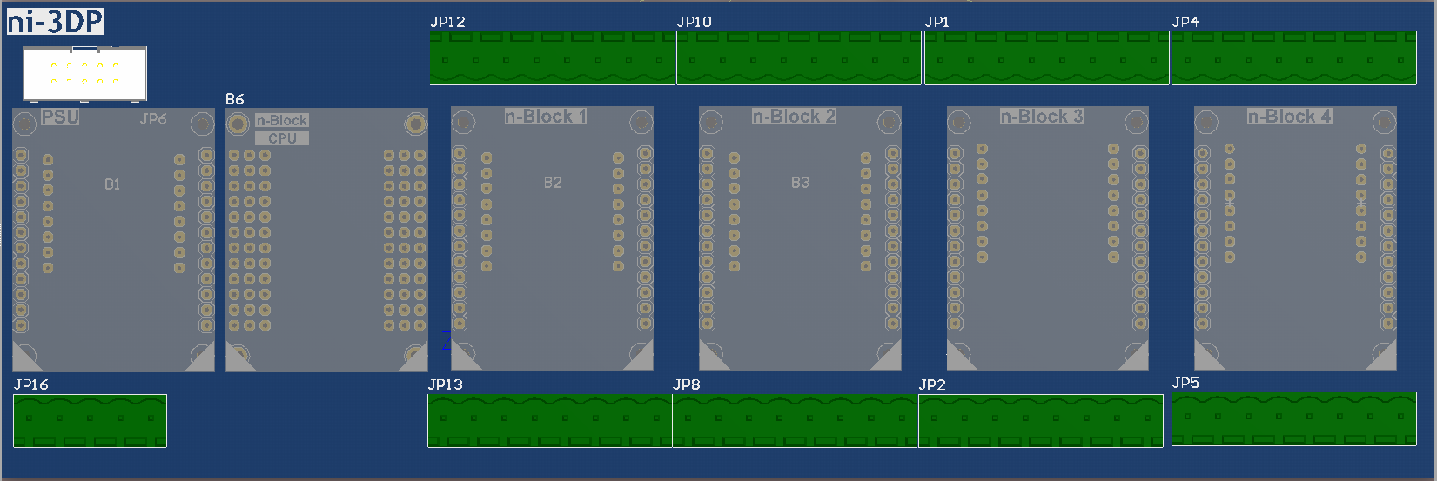
n-Blocks: Industrial I/O:
ni-3DP concept
235 X 78 mm
LCD
POWER
SUPPLY
CPU
SWITCH
INPUTS
POWER
MOSFET
OUTPUTS
4 X
STEP MOTORS

Slide 15
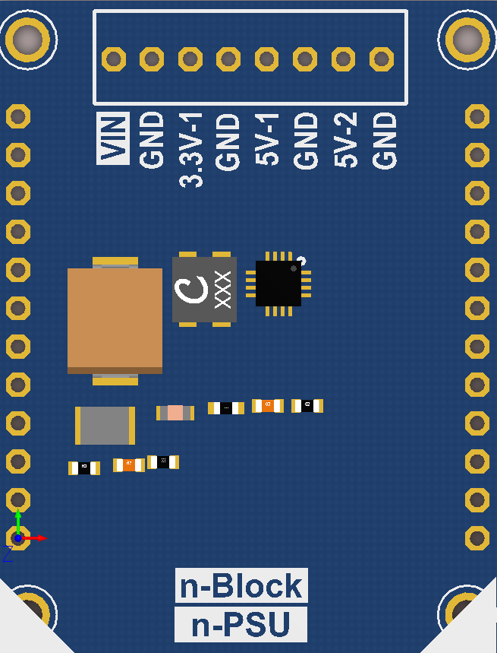
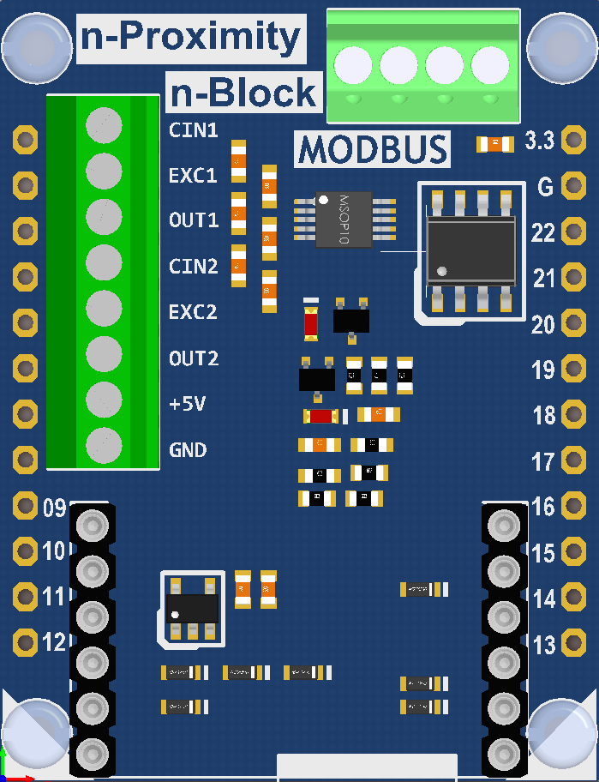
n-Blocks: Industrial I/O:
ni-3DP implementation
NEED FOR MORE n-Blocks
EXPANDABLE?
INCREASE SIZE
235 X 78 mm
LEVEL
SENSOR
LCD
POWER
SUPPLY
SWITCH
INPUTS
POWER
MOSFET
OUTPUTS
4 X
STEP MOTORS
CAPACITIVE
LEVEL
SENSOR
CPU
CAPACITIVE
PROXIMITY
USING HOT-END
AS SENSOR

Slide 16
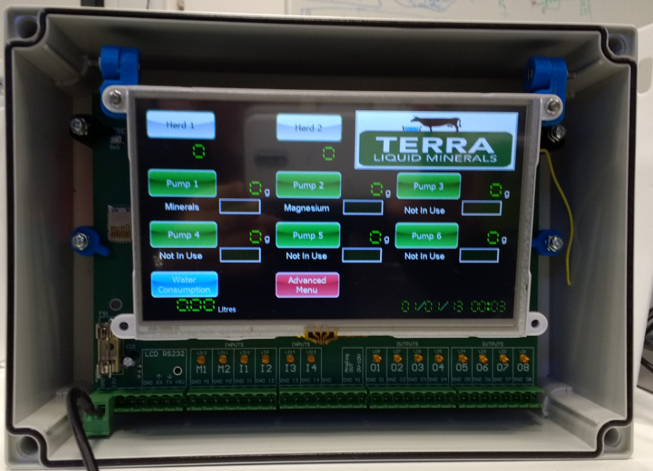
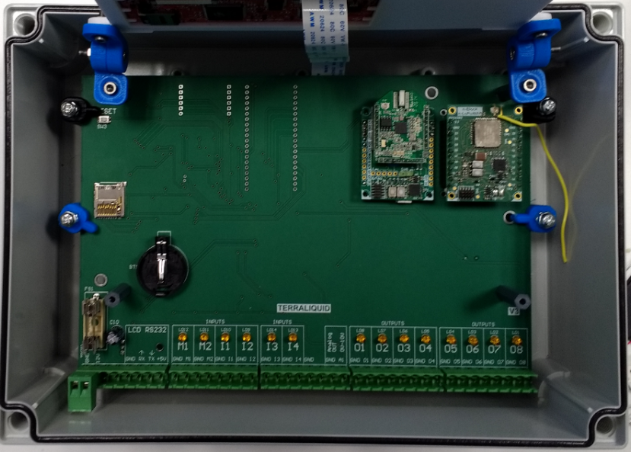
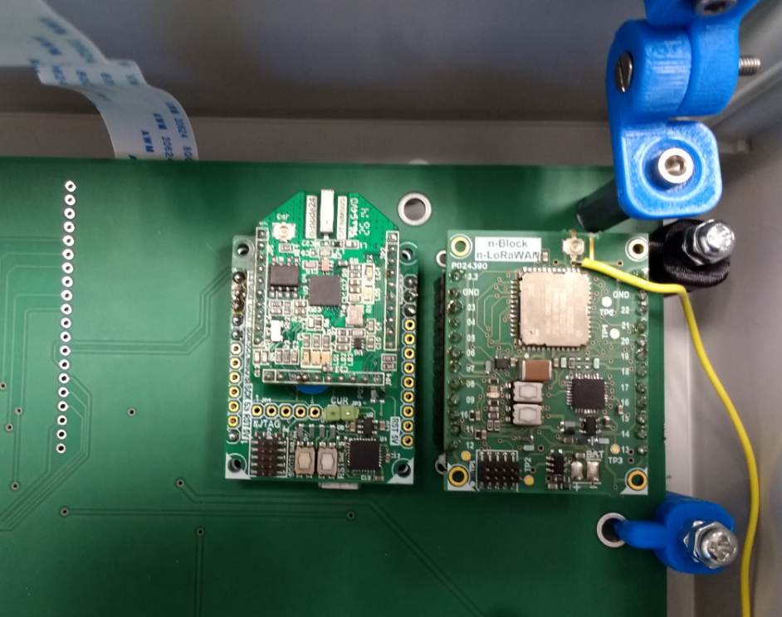
n-Blocks: Industrial I/O:
Terra Liquid Minerals Customized Controller integrating n-Blocks
N-Blocks
2.4GHz
802.15.4
N-Blocks
n-LoRaWAN

Slide 17
Questions?

Slide 18
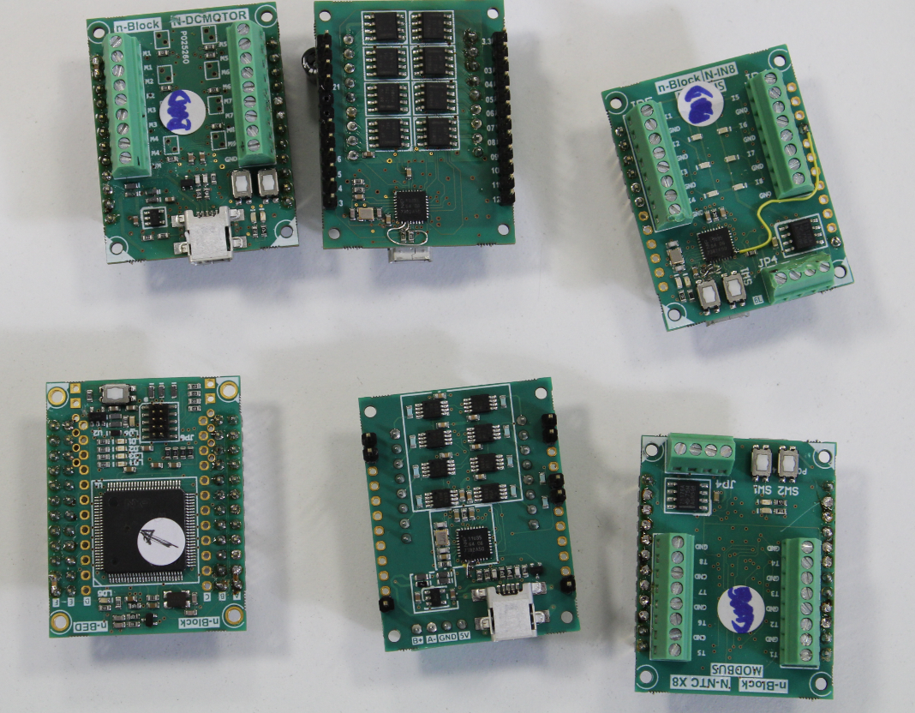
n-Blocks: Industrial I/O:
Iteration-1

Slide 19
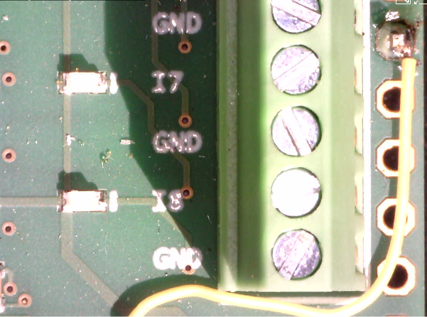
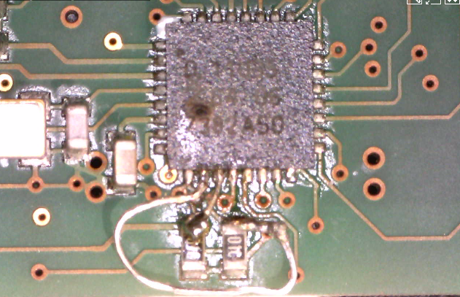
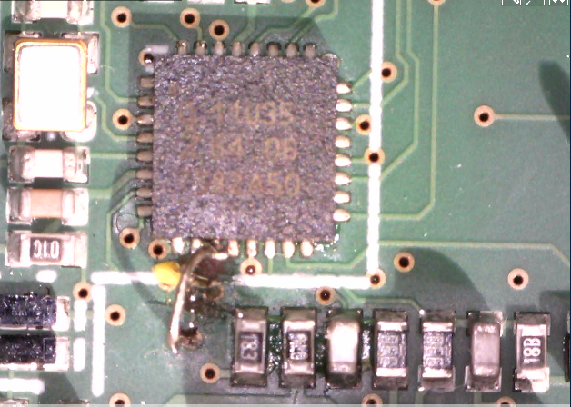
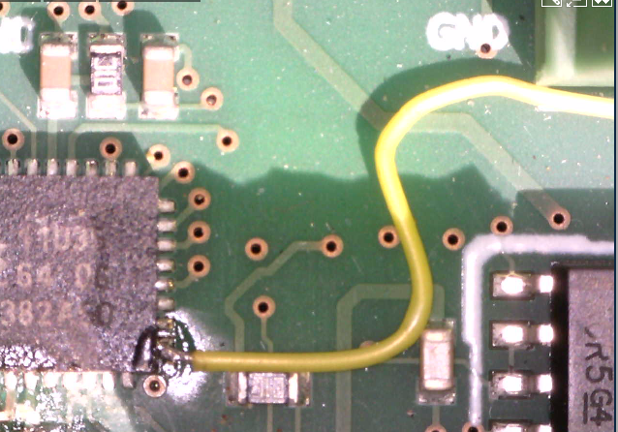
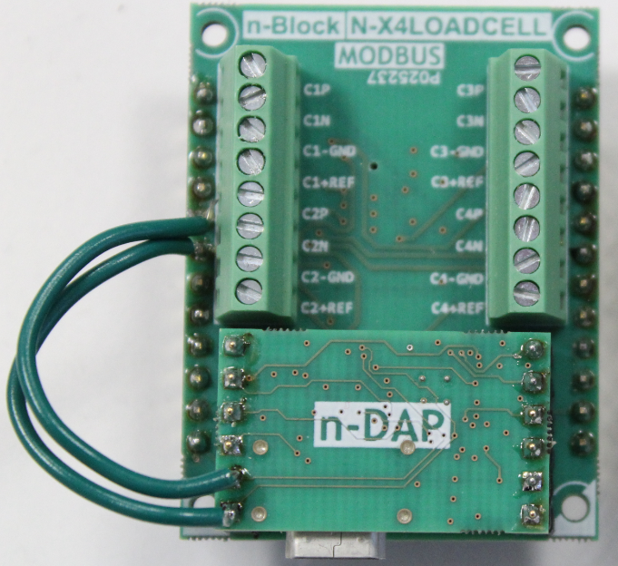
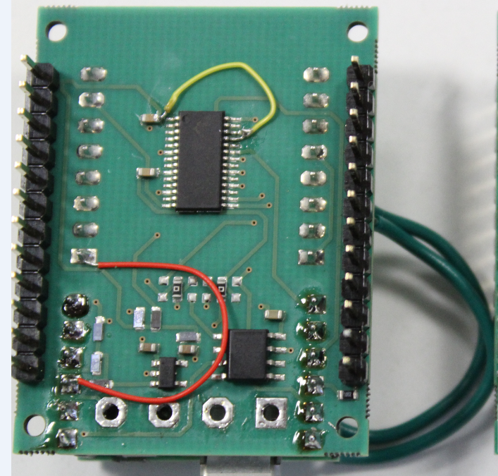
n-Blocks: Industrial I/O:
Iteration-1 patches
N-DCMOTOR
N-NTC
N-IN8
N-X4LOADCELL

